Slide 1
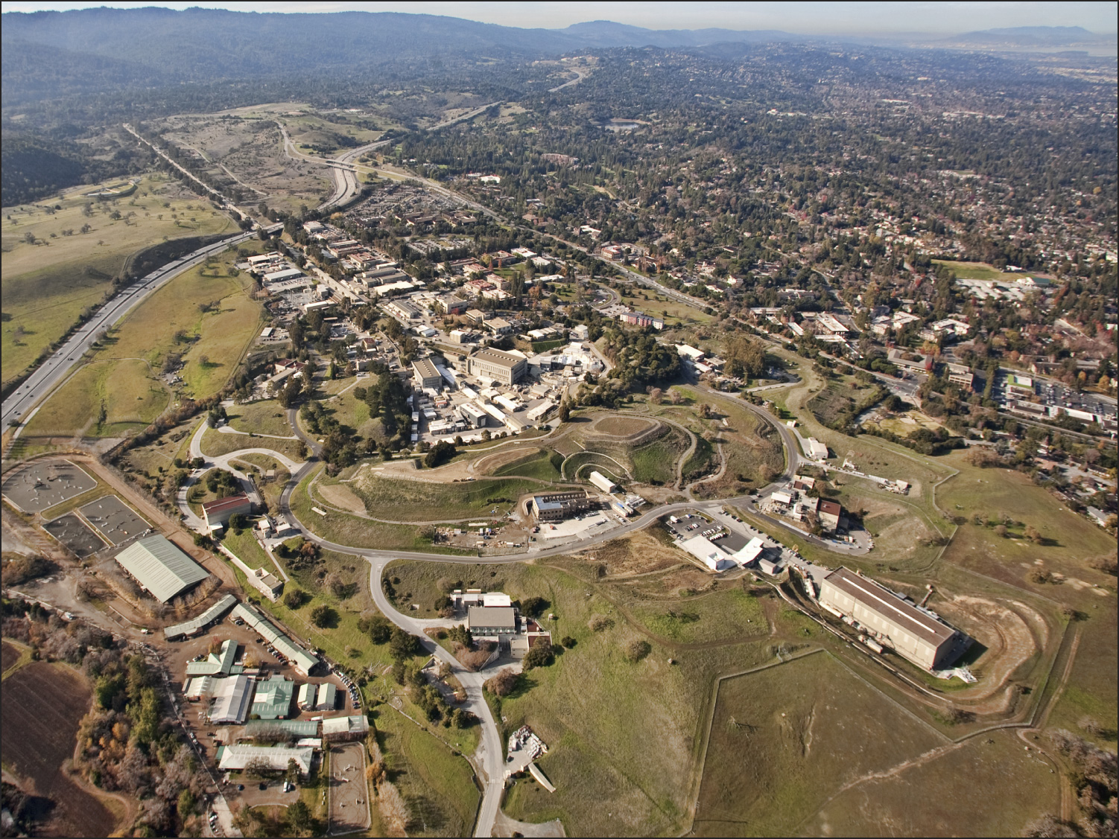
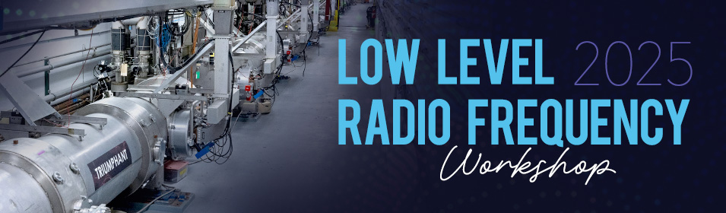
SLAC National Accelerator Laboratory
Lab Efforts & LLRF
Jorge Diaz
October 13, 2025
LLRF Workshop 2025
Newport News, VA

Slide 2
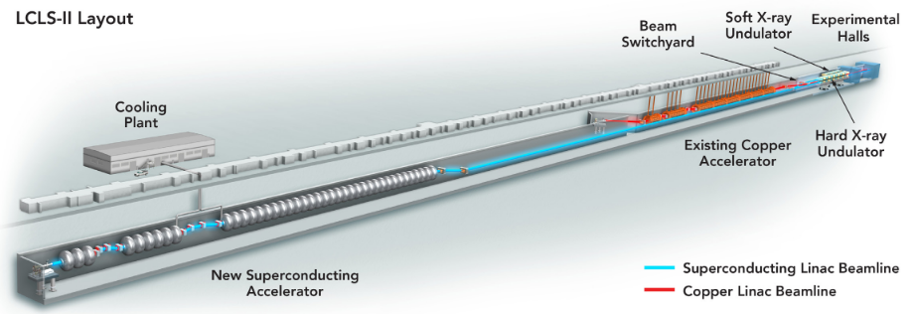
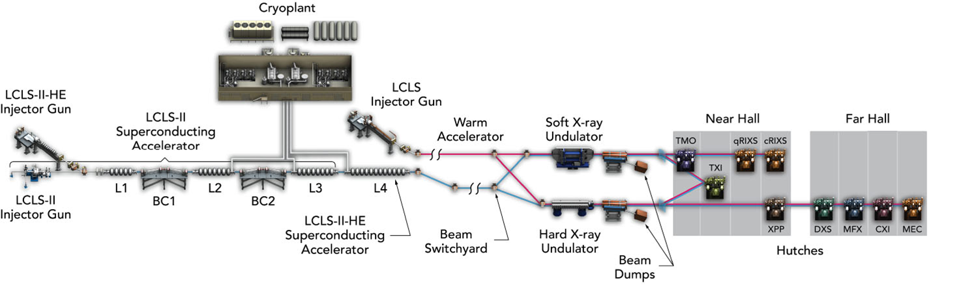
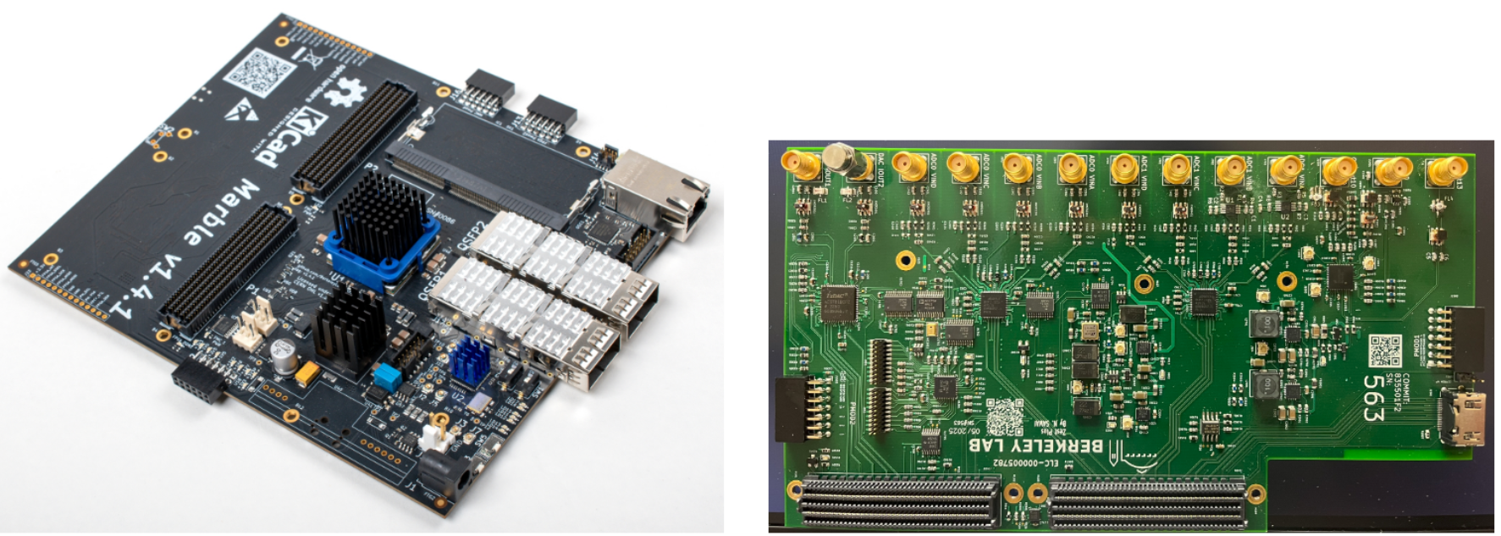
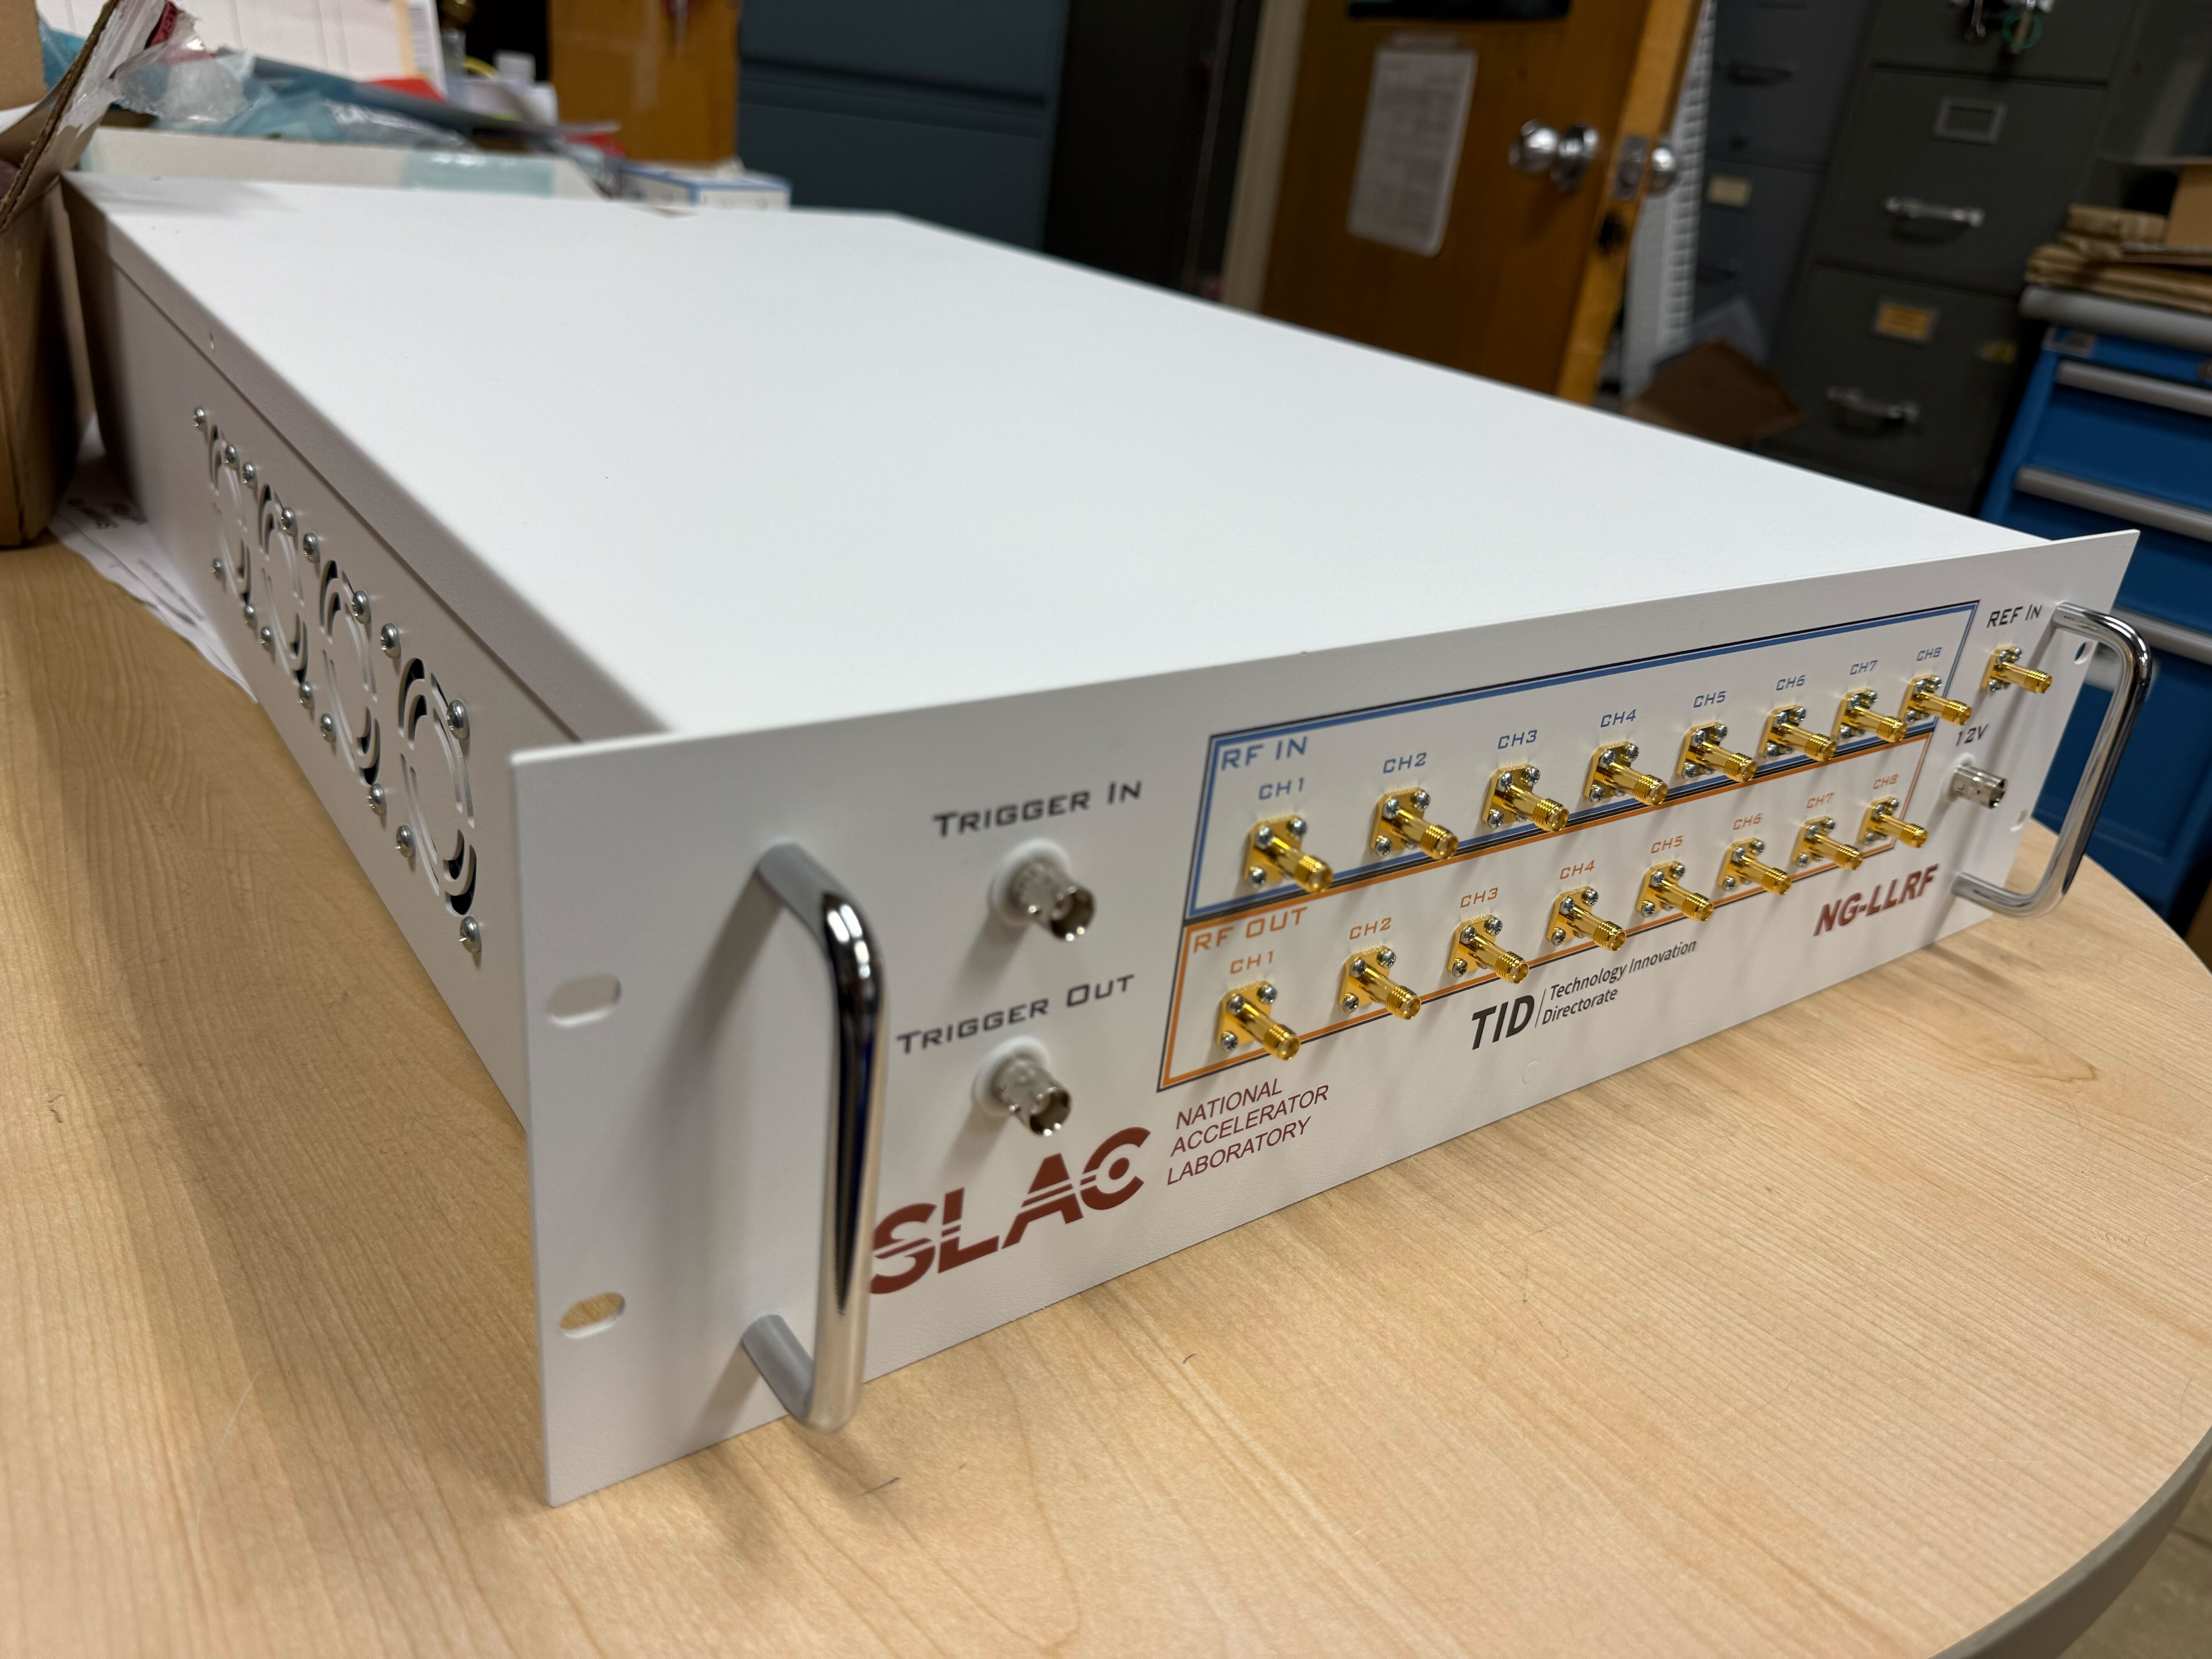
SLAC Projects / Updates
LCLS-II
Regular beam delivery to users
LLRF functionality regularly updated to support various accelerator modes
LCLS-II-HE
High Energy upgrade to the SRF Linac
Provisions for a new low emittance injector
184 new SRF cavities and LLRF controllers
LCLS-I Electronics Modernization
Modernization of the Normal Conducting Linac control system from its 1980’s legacy
LLRF system built and tested “on-beam” based on Marble/Zest
RFSoC Based Controllers
Development of next generation LLRF systems on new platforms

Slide 3
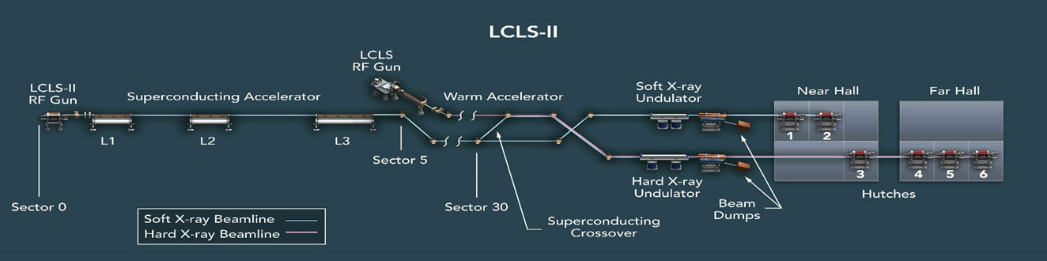
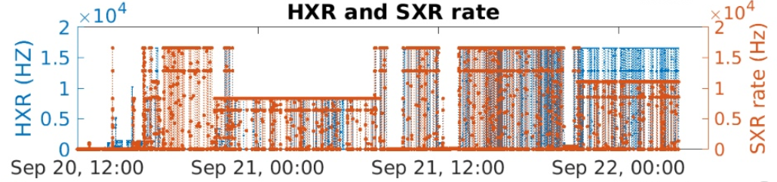
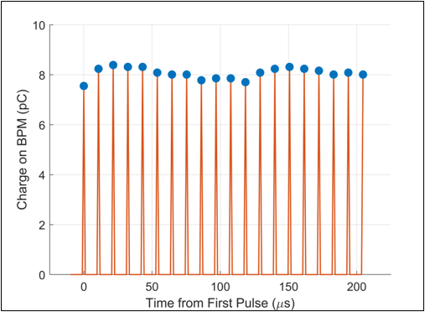
LCLS-II Status
LCLS-II is the newly operational SRF Accelerator at SLAC, commissioned in 2023, and now used to drive two undulator systems, HXR and SXR.
The accelerator is regularly turned fully off and recovered to accommodate installation of downstream equipment for future programs
Accelerator Recovery is swift, and Uptime has been excellent
The LLRF System has performed well, and has set a high standard for future LLRF systems at SLAC
Current development efforts are focused on improving aspects of beam delivery
Multiplexed delivery to both hard and soft X-ray undulators at the same time.
Higher average beam rate and burst mode deliver
Beginning Mid-December 2025, LCLS-II will be turned off!
For a major upgrade called LCLS-II-HE
Beginning Mid-December 2025, LCLS-II will be turned off!

Slide 4
LCLS-II-HE Project Scope
Install 23 additional cryomodules (L4 Linac) to increase the LCLS-II accelerator energy to 8 GeV.
Install new cryogenic distribution system between Cryoplant-2 and the new L4 Linac.
Upgrade soft X-ray undulator for 8 GeV operation.
Upgrade the X-ray Pump Probe (XPP) instrument for MHz beam and data rates and upgrade the photon transport optics and beamline components through the Hard X-ray instruments.
For extended hard X-ray performance, develop conceptual design of a Low-Emittance Injector (LEI) including a tunnel design to support its construction. Also fund construction of a prototype high gradient SRF gun (30 MV/m cathode field) for the LEI.
23 new cryomodules (CM) added to the LCLS-II SRF linac
New cryomodules will be nearly identical to the LCLS-II cryomodules
HL cryomodules and bunch compression scheme remain the same
5 total linac segments, the first four (L0-L3) accelerating the beam to 4 GeV
New final section (L4) accelerating the remaining beam to 8 GeV
46 new LLRF rack systems to regulate 23 new cryomodules

Slide 5
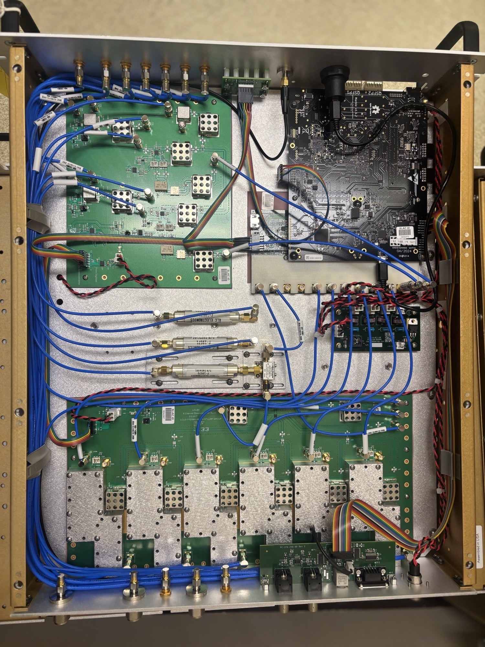
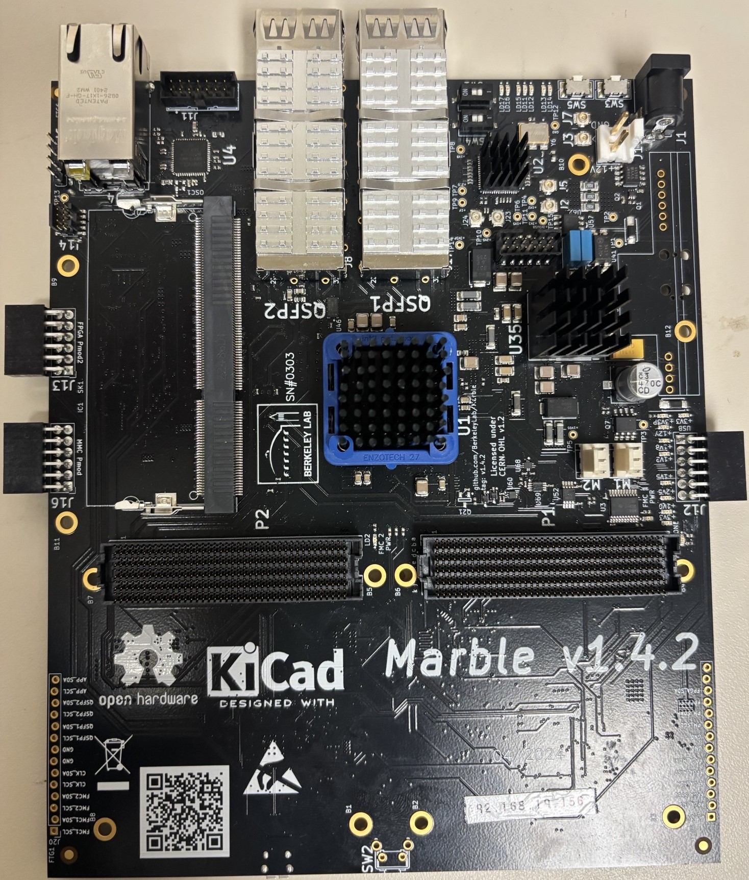
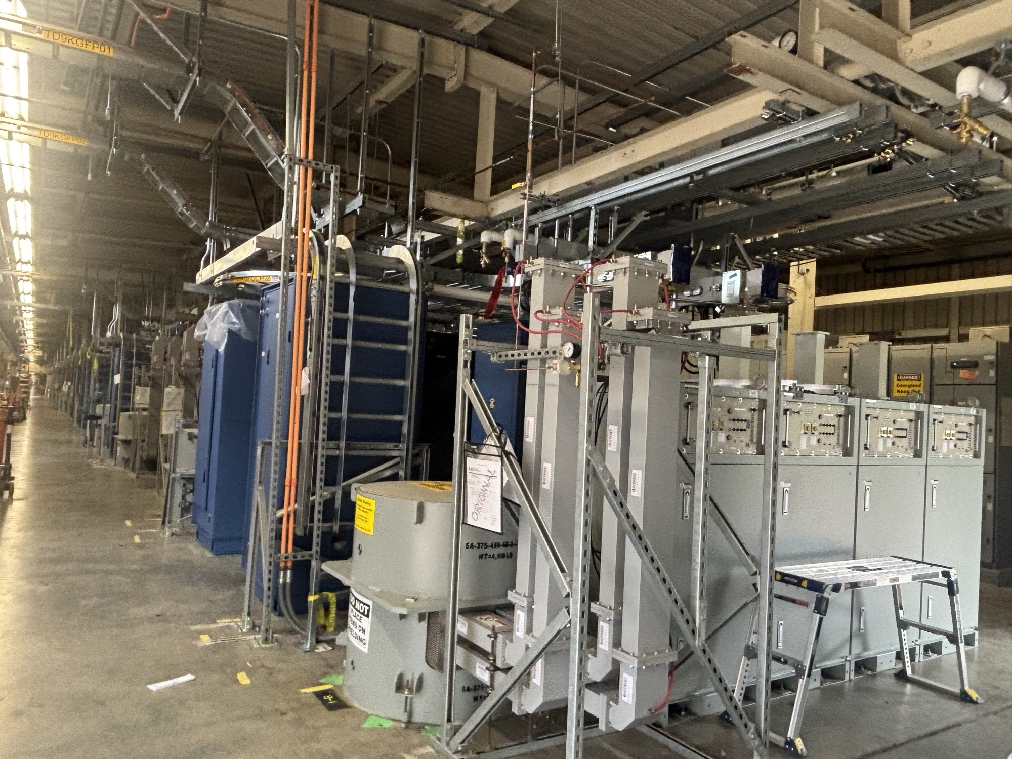
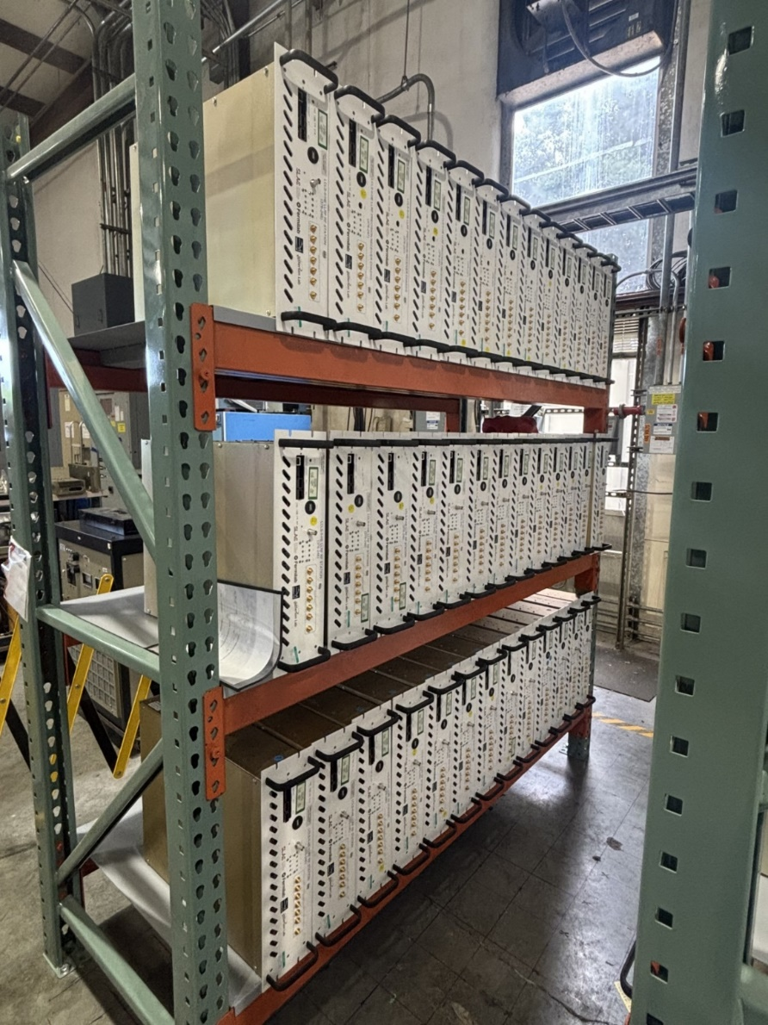
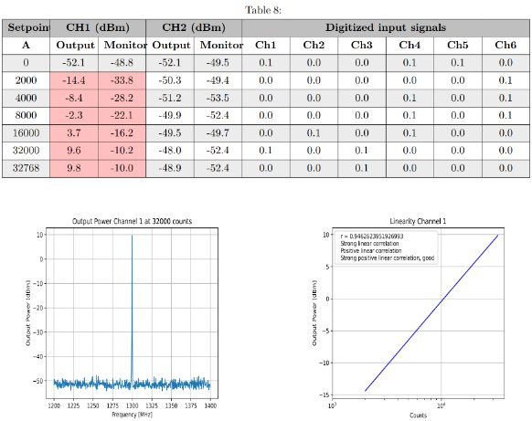
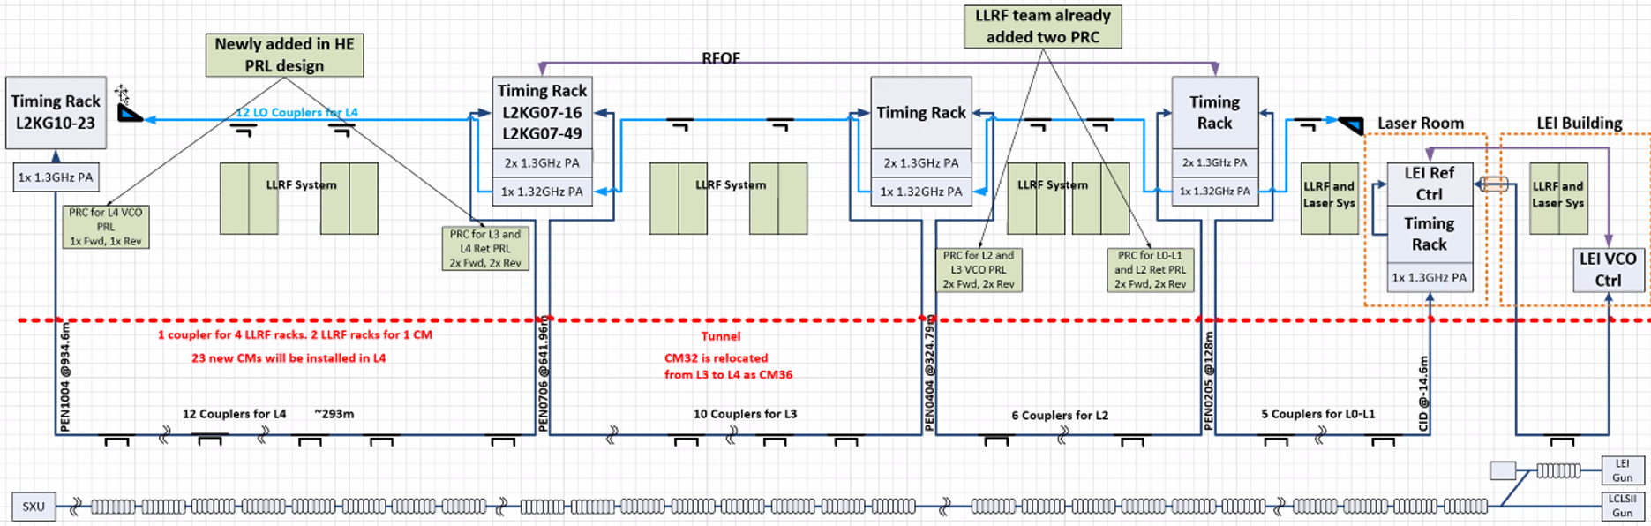
LCLS-II-HE LLRF
HE LLRF Control – Jing Chen
LCLS-II-HE will add 184 SRF cavities to the LCLS-II linac
46 new LLRF Racks
Hundreds of new RF chassis
LLRF fabrication, testing and installation are ramping up now
HE LLRF system is similar to LCLS-II, but built around the Marble/Zest platform
Full system validation on SRF cavities to begin next week at FNAL during Cryomodule Testing
HE PRL Design/Installation – Nick Ludlow
The Phase Reference Line for LCLS-II-HE provides a 1.3 GHz phase reference signal to the LLRF system.
In some locations bi-directional RF referencing is used to cancel drift
Potential changes to the existing PRL installation include:
Moving the MO from sector 2 to the Injector CID for increased beam stability
Moving the MO to sector 10 and replacing the RF over fiber system with a coaxial line to the experiment hall for better stability for experiments

Slide 6
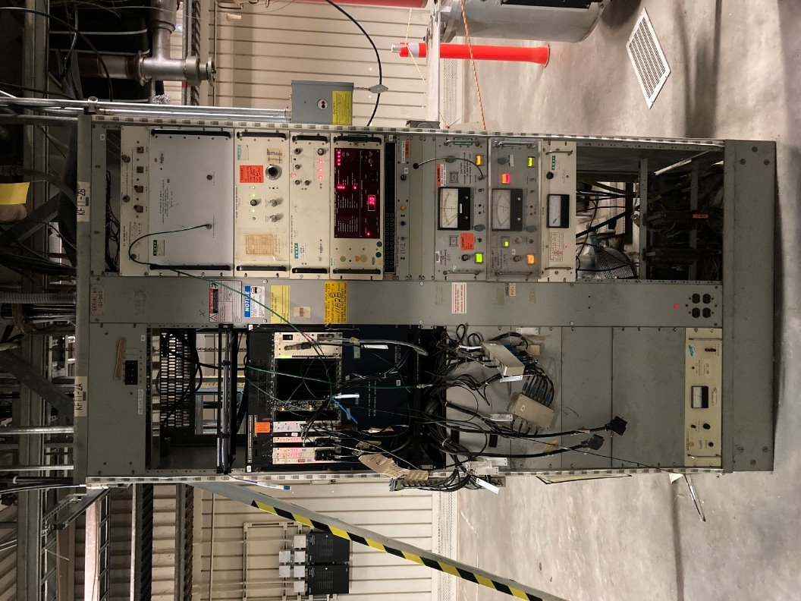
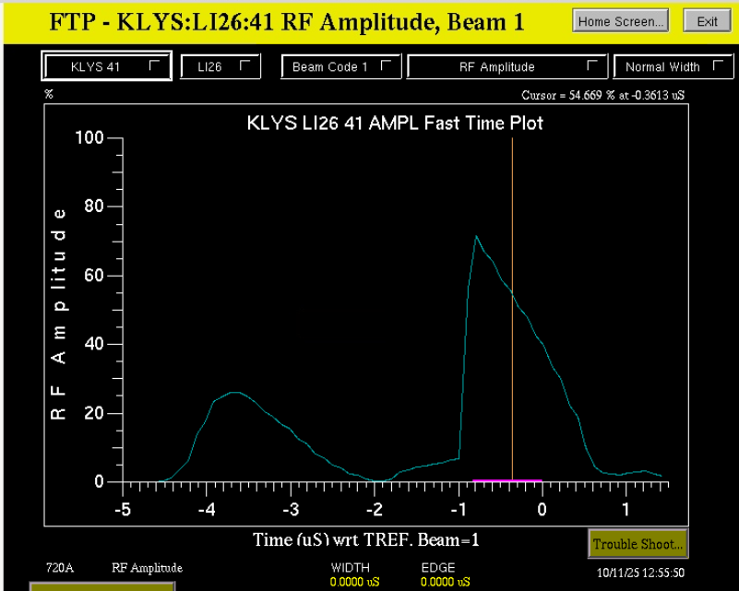
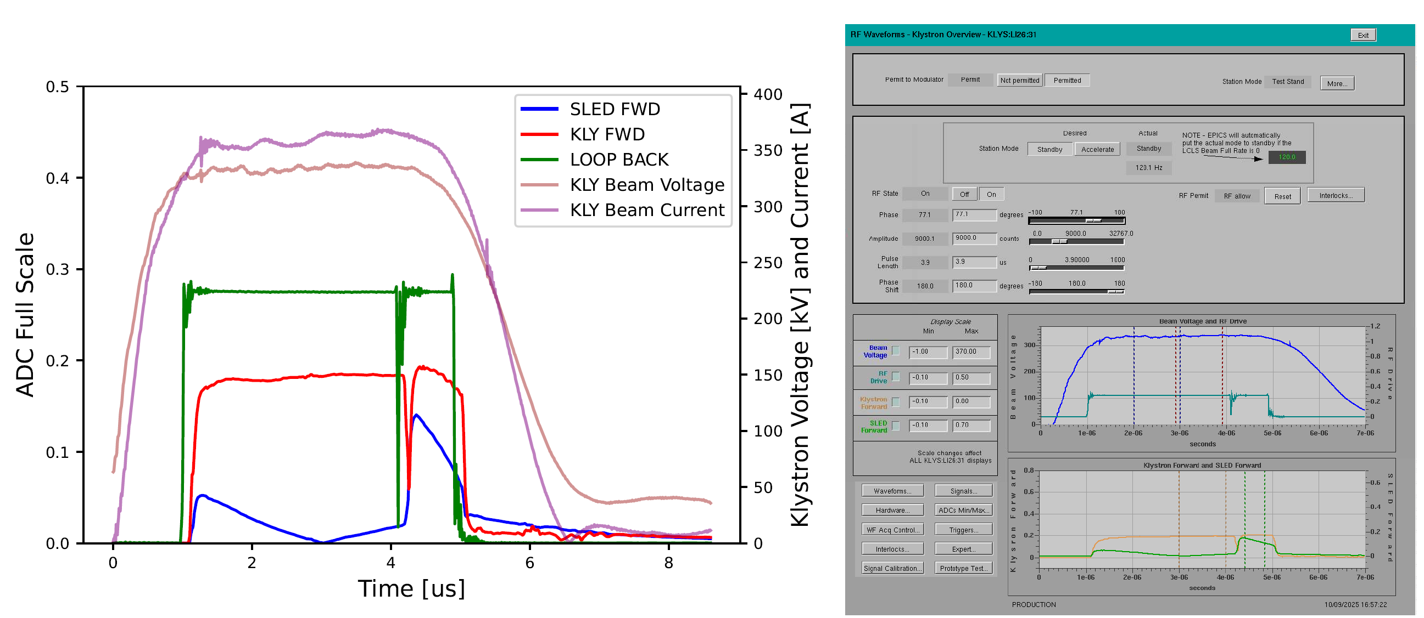
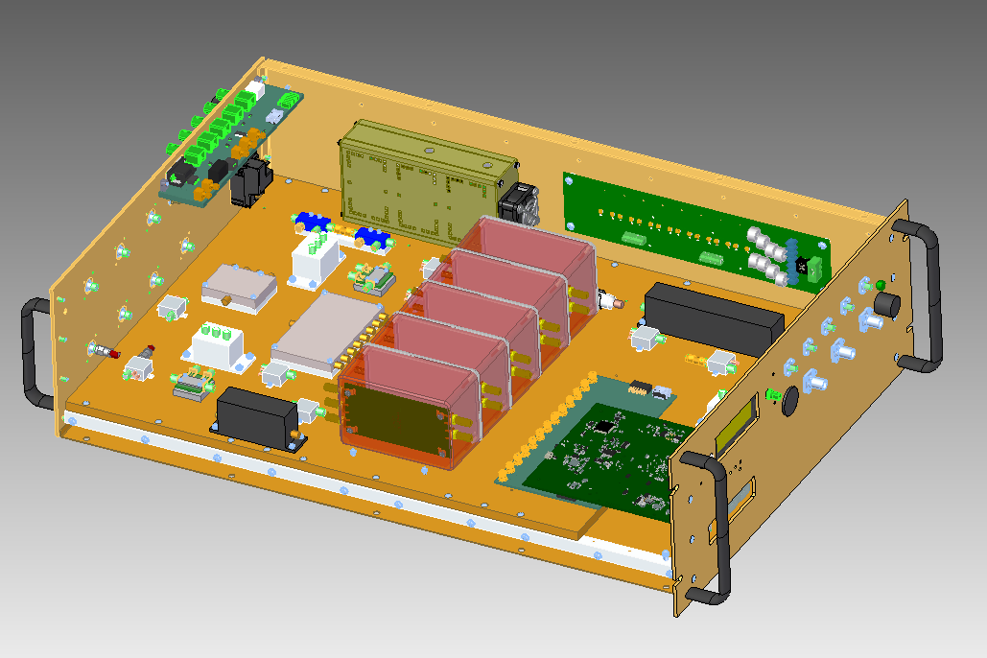
Linac Electronics Modernization – LLRF
The LLRF control system used to control the LCLS NC Linac is based on 1980’s CAMAC technology and still works reliably. But limits the functionality of the RF system need to be addressed.
An adaptation of the SC Linac LLRF system has been developed for the NC linac to control LCLS klystrons in pulsed mode.
The entire rack size legacy LLRF system now can easily fit in a single 4RU enclosure.
The system makes use of the Marble/Zest platform now widely being used at SLAC, which simplifies hardware design, control system development, and long-term maintenance.
The system provides for the full functionality of the CAMAC system into a single RF Station and enables NC Linac Operators and Physicists to control the linac in new and interesting ways.

Slide 7
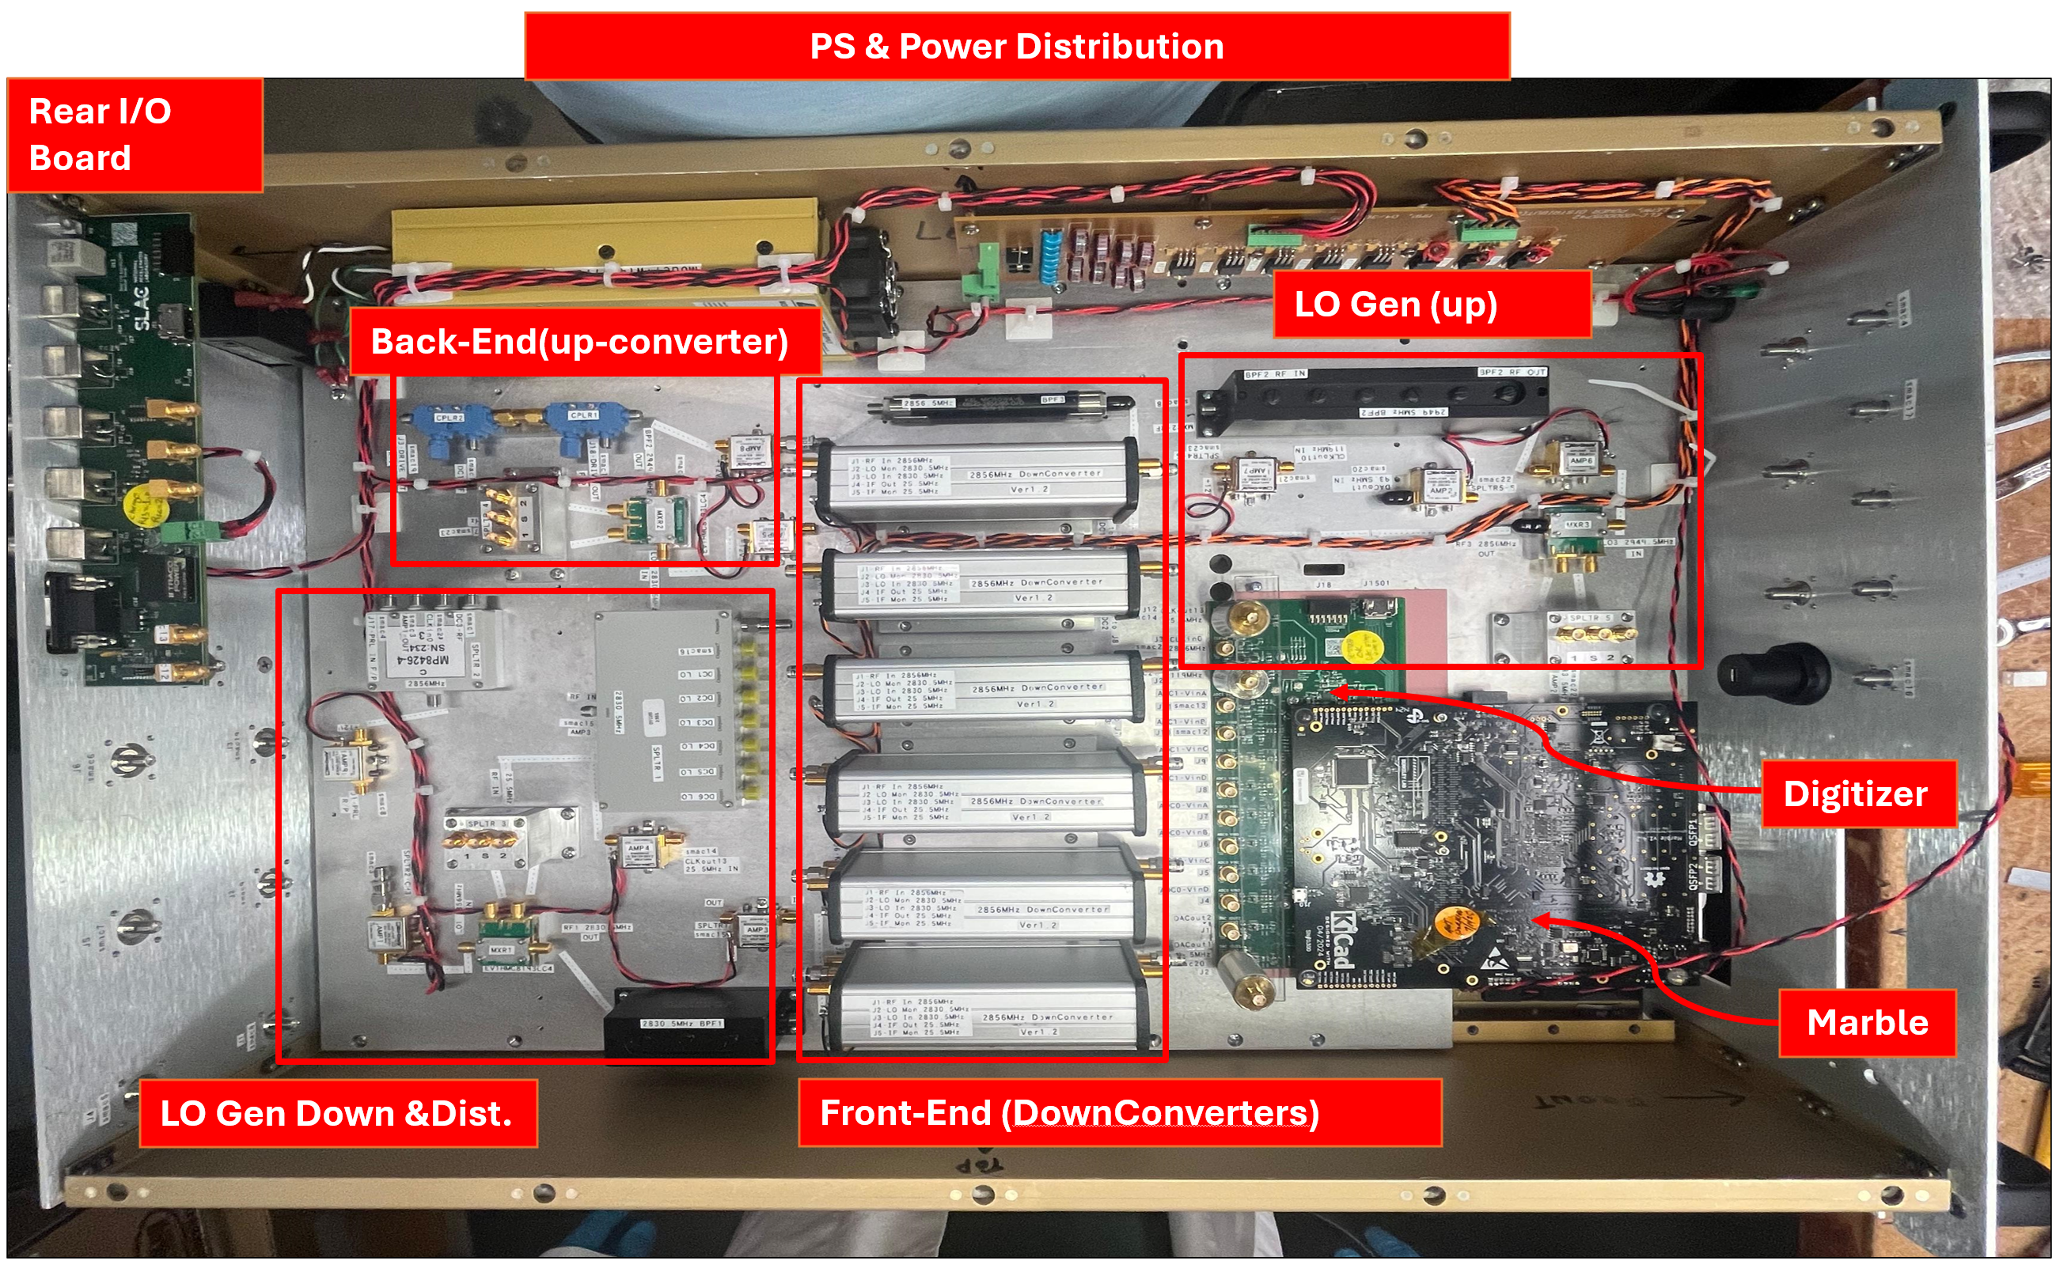
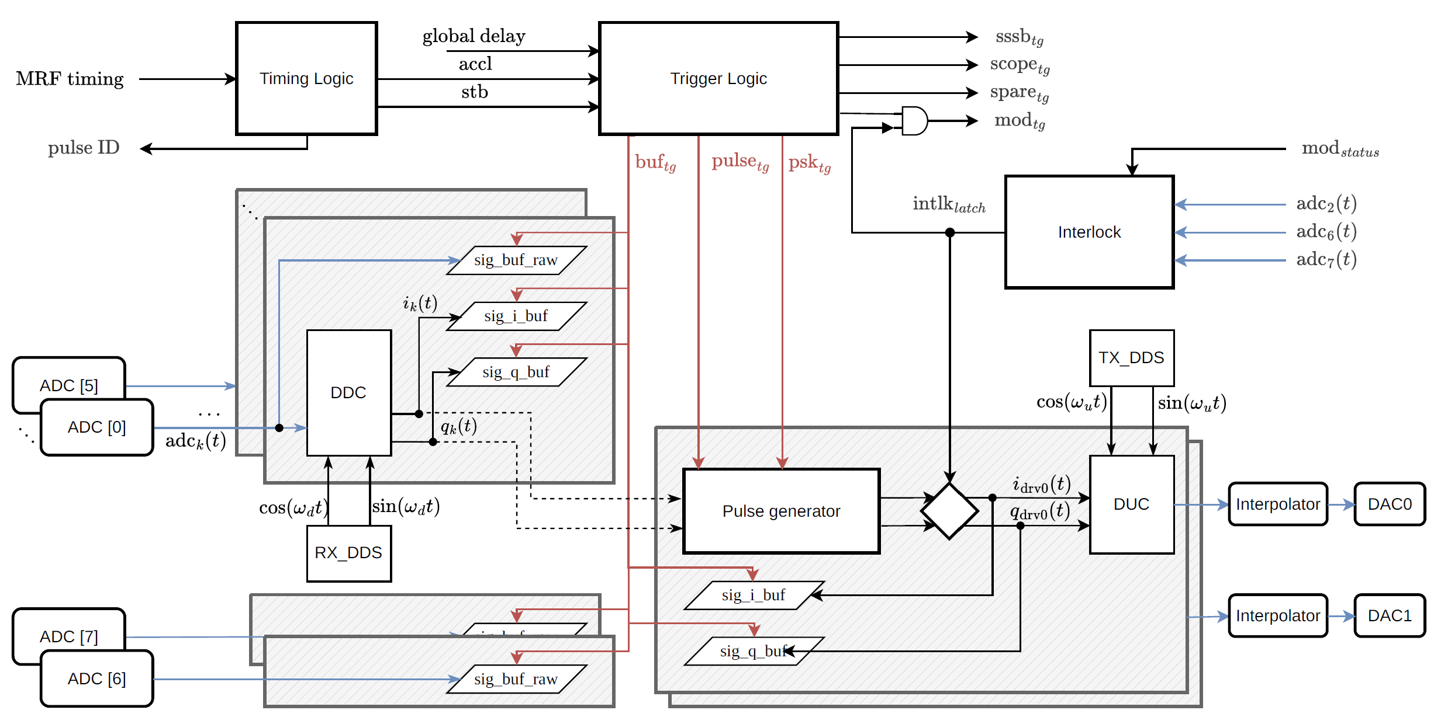
Linac Electronics Modernization – LLRF
LEMP LLRF Control – Nashat Sawai
NC Linac LLRF hardware design is built around Marble/Zest
New signal processing schemes were needed.
Low noise, single channel, down converters
DC signal processing
Trigger input/output
Clocking and LO Generation redeveloped for the new platform based on 2856 MHz, the accelerating frequency of the NC linac
LEMP LLRF Control – Jorge Diaz
The core of the firmware design was developed by the LLRF team at LBNL and shared across a multi-lab collaboration.
Many firmware components of the system are shared with other LLRF projects among several accelerators.
ALS-U at LBNL
AWA at Argonne
It has now been modified at SLAC to meet the requirements and functionality of LCLS.
This new LLRF system now approved for regular use on the LCLS NC beam

Slide 8
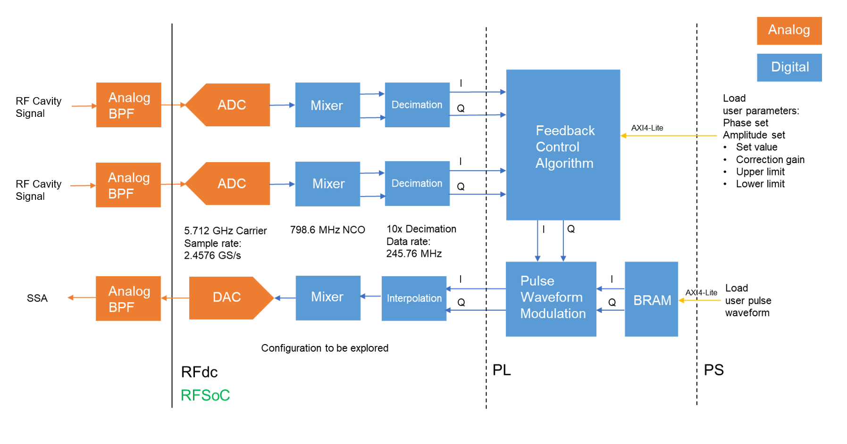
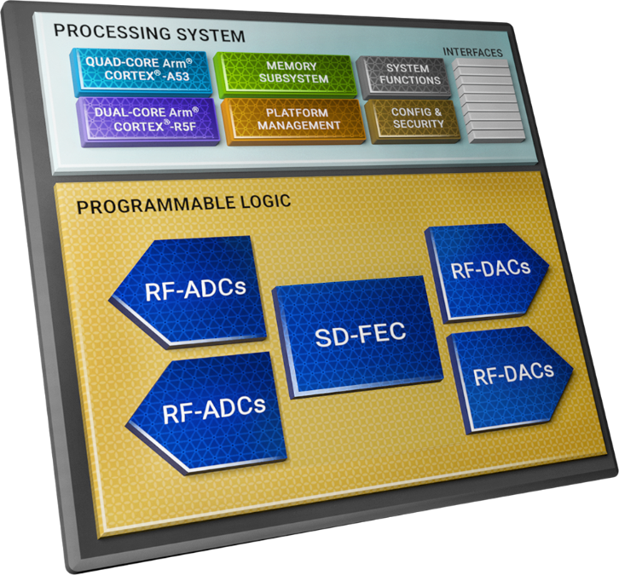
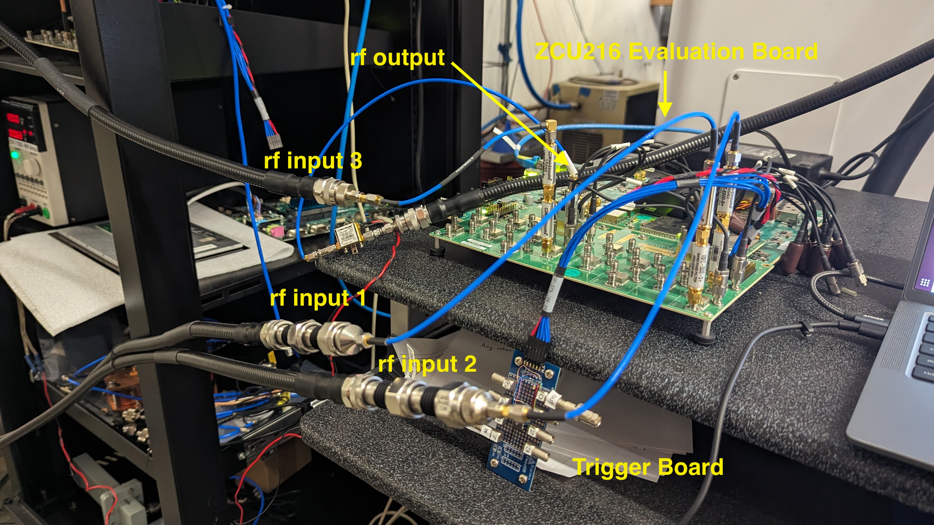
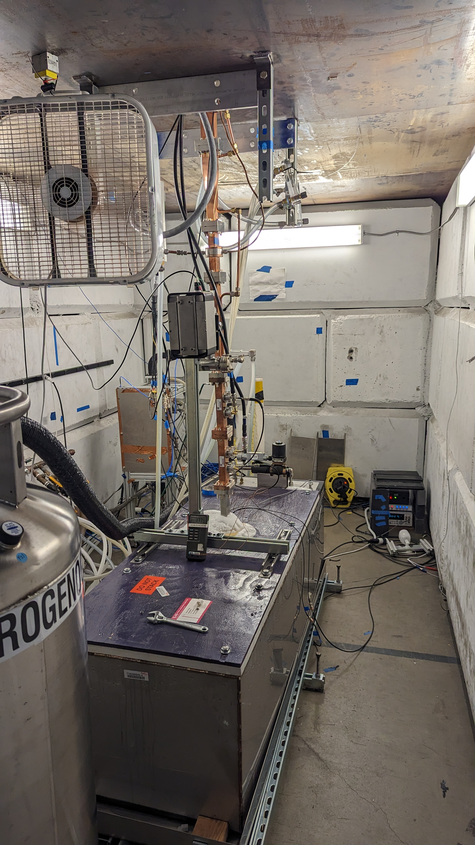
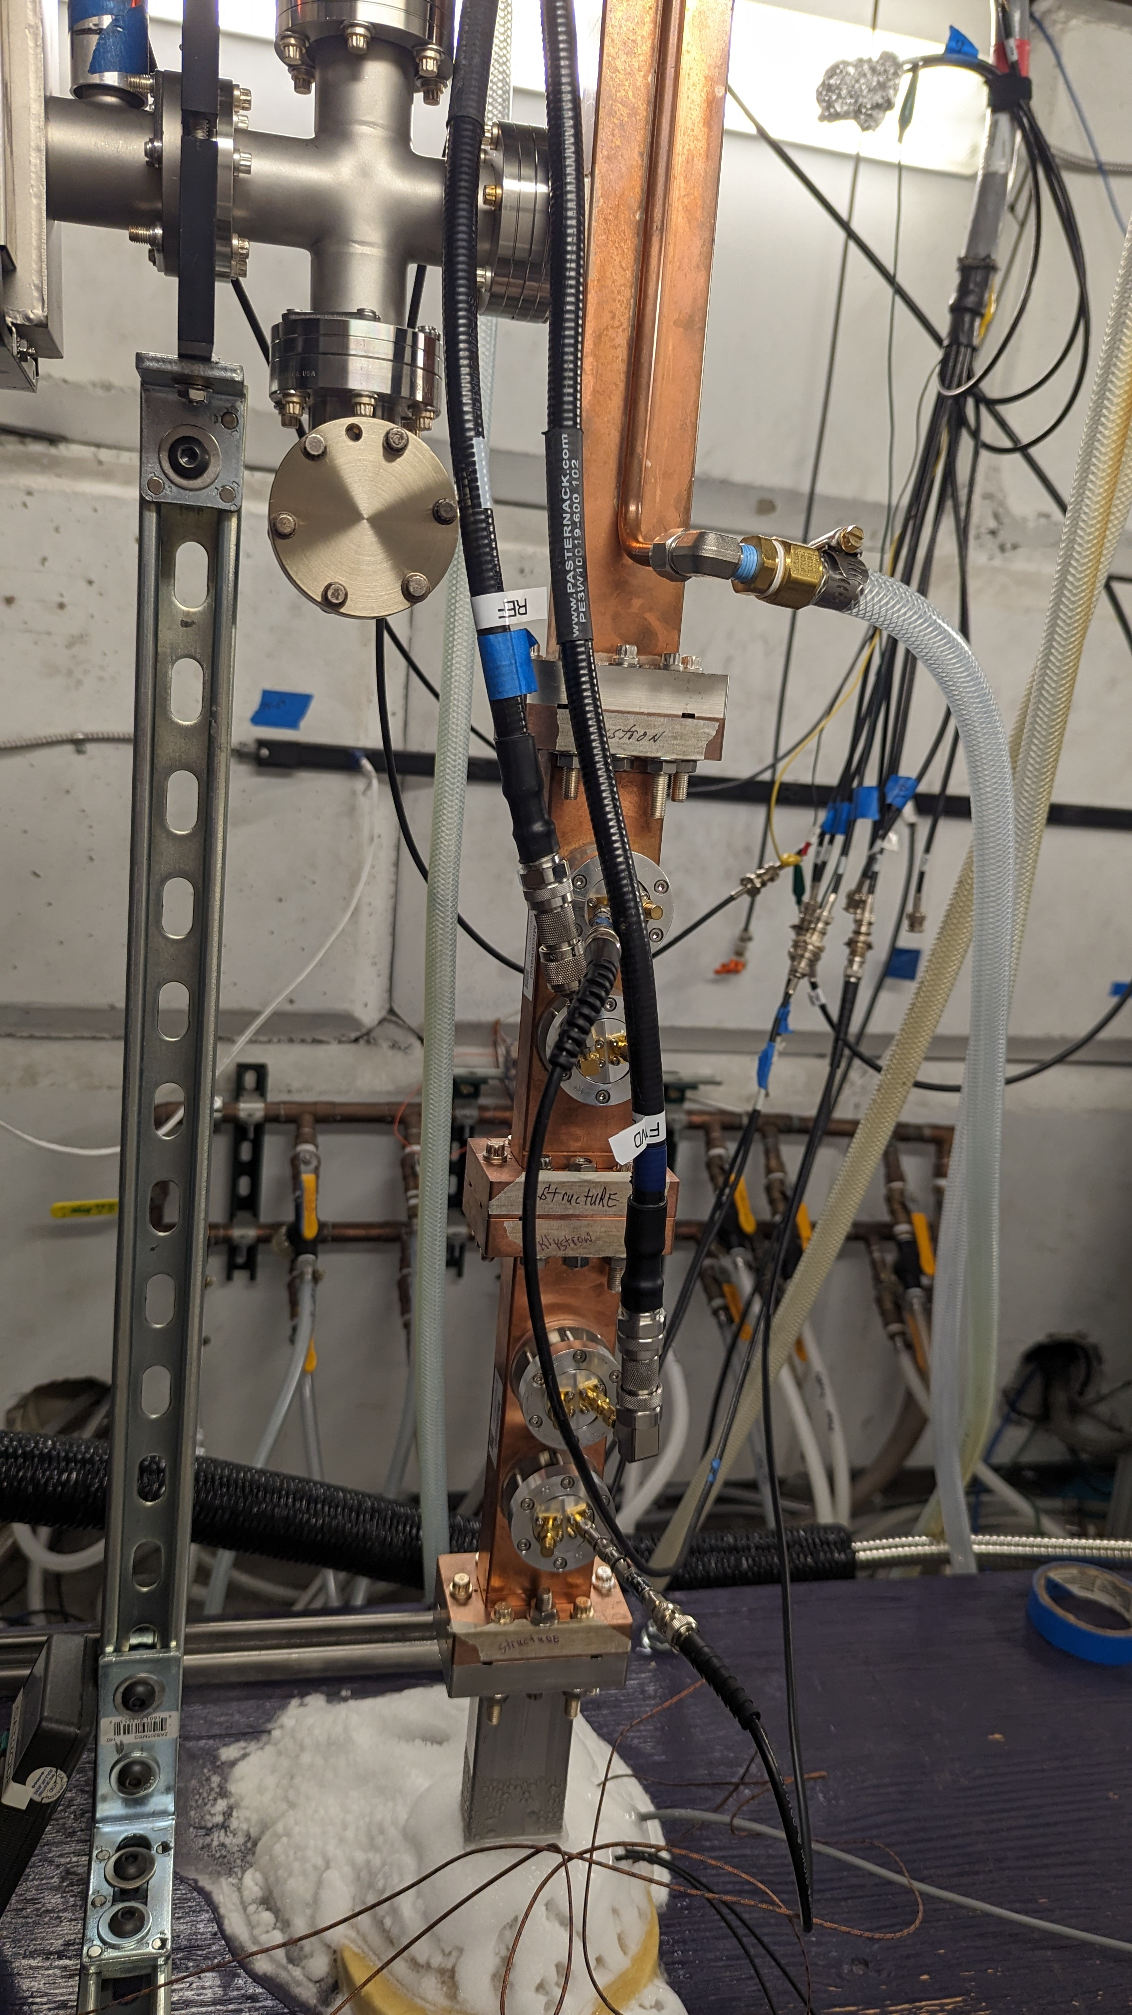
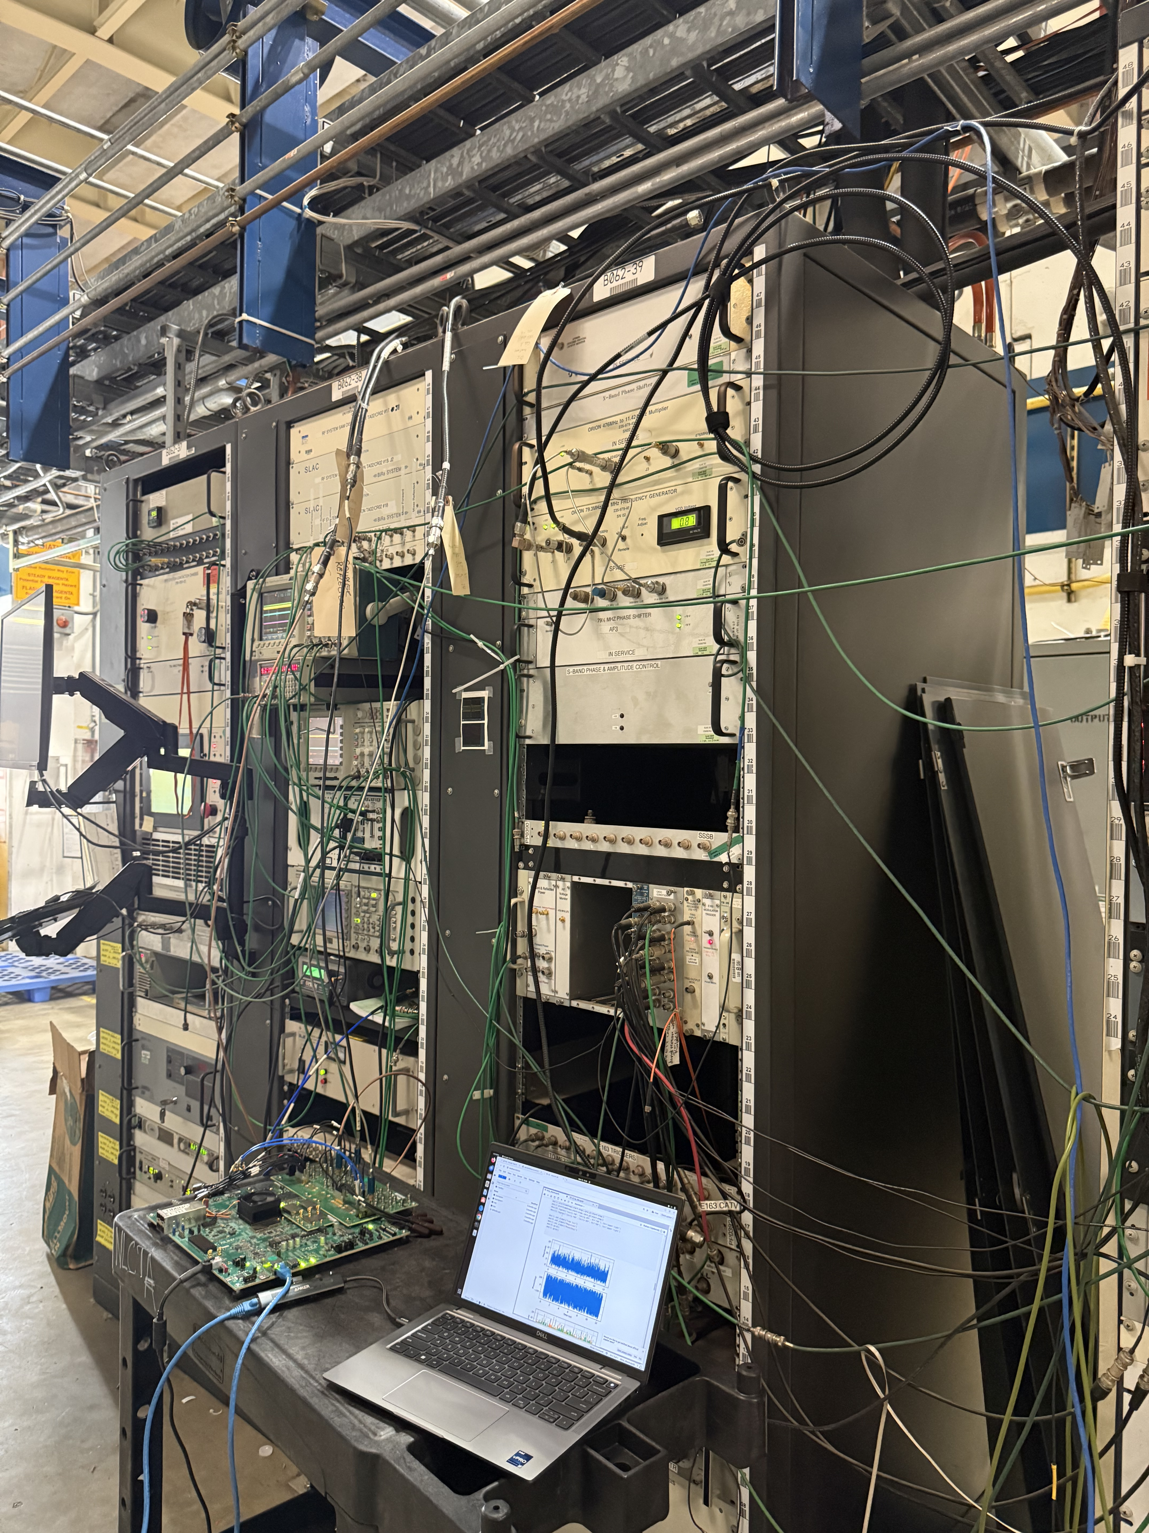
RFSoC-based LLRF Control System R&D at SLAC
System Block Diagram
System Summary:
Implemented with integrated data converters in RFSoC
Direct RF sampling even in higher order Nyquist zone
8/16 ADCs and 8/16 DACs for a compact LLRF platform
Maximum direct RF input frequency 6 GHz
Adaptable RF frequency: switch between C-band and S-band in software
Loopback phase jitter 80 fs for C-band and 50 fs for S-band
DAC
C. Liu et al., LCWS , 2024, doi:10.1051/epjconf/202431502008
C. Liu et al., IPAC’25, arxiv.org/abs/2505.22876
NG-LLRF Chassis
High-power test with C-band test stand and prototype Cool Copper Collider cavity
S-band @NLCTA
C. Liu et al., Review of Scientific Instruments, 2025, doi:10.1063/5.0265666
C. Liu et al., ICALEPCS, 2025, doi:0.18429/JACoW-ICALEPCS2025-MODR005

Slide 9
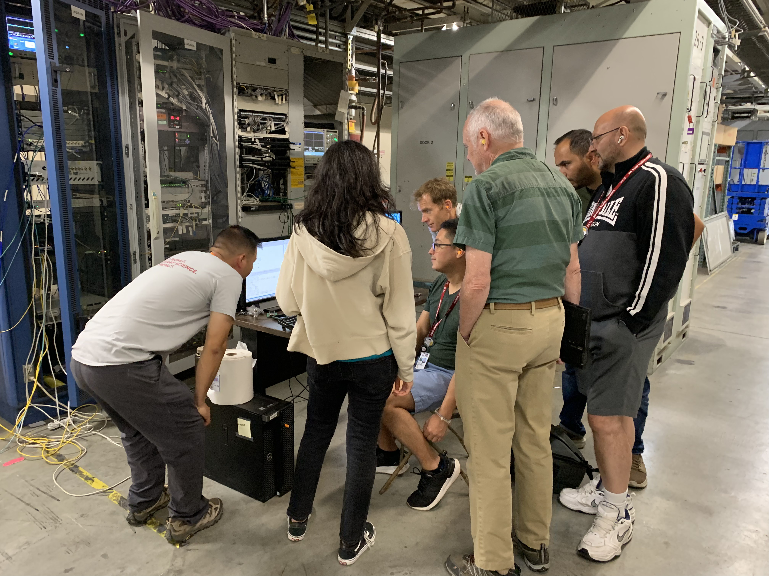
Thank you for your time.
We look forward to speaking with you at the 2025 LLRF Workshop!
LCLS-II-HE
Jing Chen, SRF LLRF Systems: Tuesday
Nick Ludlow, Phase Referencing for HE: Wednesday
LCLS-I Electronics Modernization
Nashat Sawai, NCRF LLRF System Design: Tuesday
Jorge Diaz, NCRF LLRF Firmware: Wednesday
RFSoC
Please reach out to Chao Liu at SLAC regarding any questions

